Slide 1
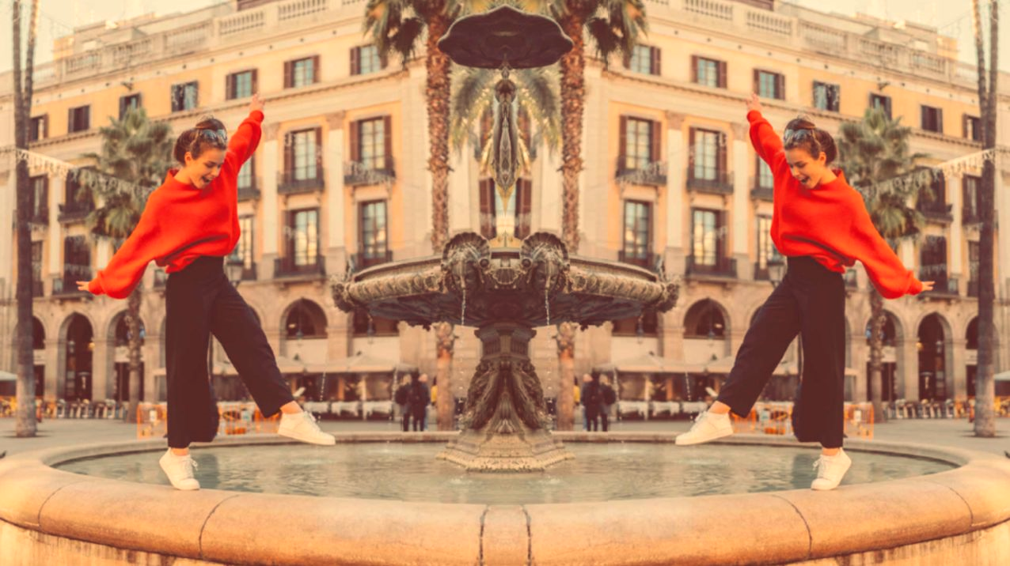
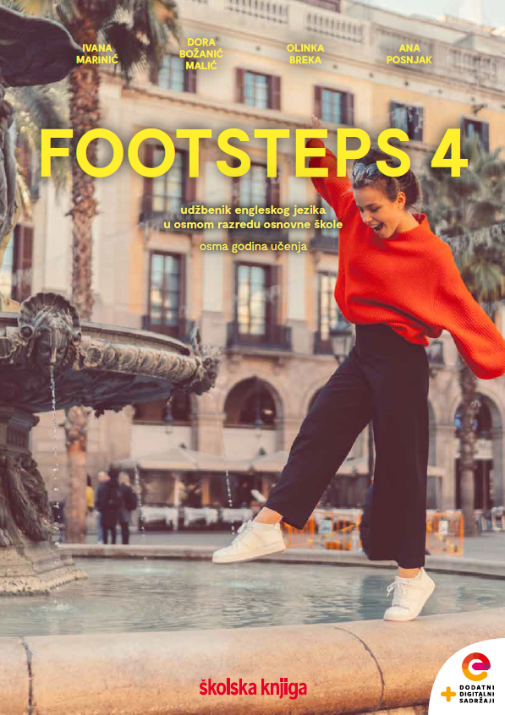

UNIT 2; Inspired
Lesson 2; I see…

Slide 2
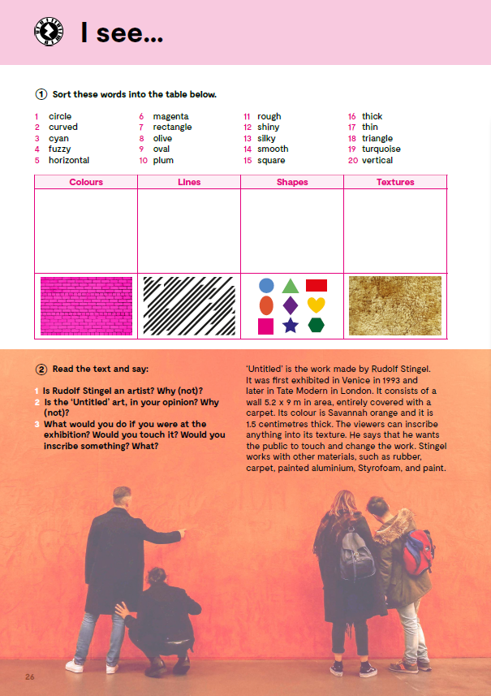
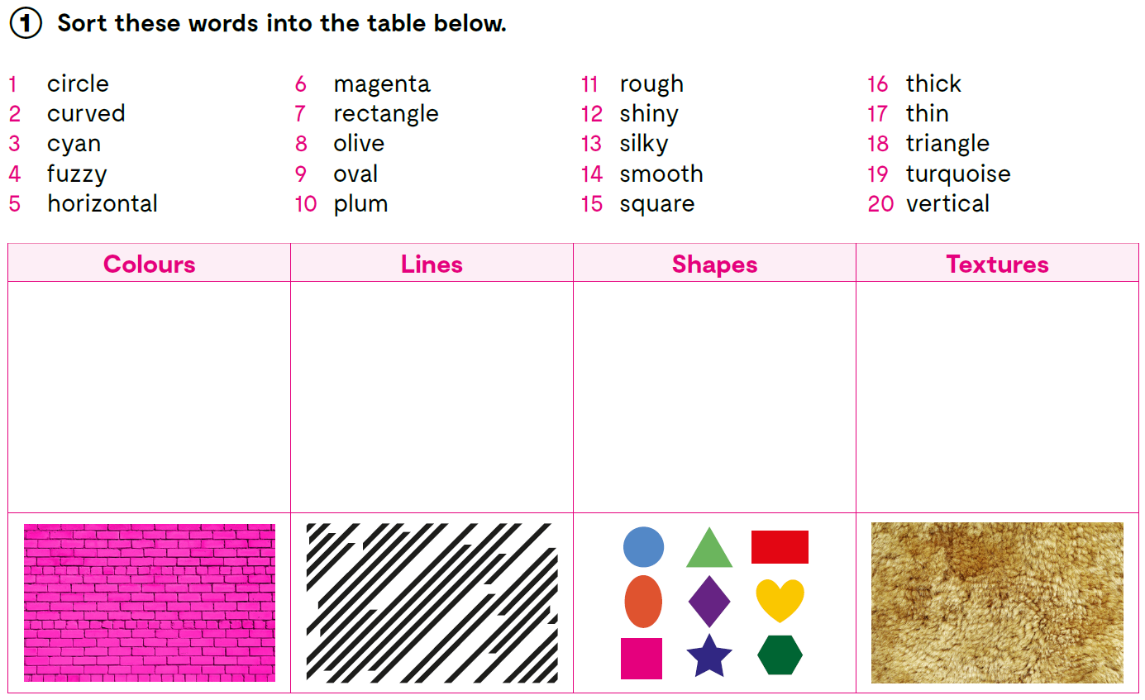
Do you know the meaning of these expressions?
linija
tekstura
oblik
neizrazit
glatko
cijan (boja)
zaobljen
sloj
tirkizna (boja)
magenta (boja)
debelo
upisati, zapisati
stiropor
opisati, slikati
suncokreti
line
texture
shape
fuzzy
smooth
cyan
curved
layers
turquoise
magenta
thick
to inscribe
Styrofoam
to depict
sunflowers
cyan
curved
circle
fuzzy
magenta
horizontal
rectangle
rough
olive
thick
oval
shiny
plum
thin
square
silky
turquoise
vertical
triangle
smooth

Slide 3
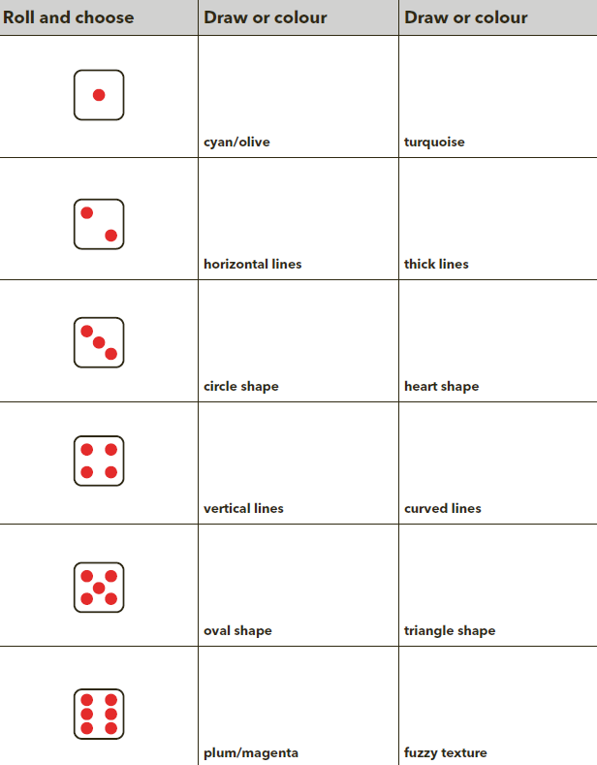
Roll a dice and draw or colour what you get. https://www.online-stopwatch.com/online-dice/
Send your work of art to a friend and see what he or she thinks about it.
Answer these questions about the drawing you received.
What do you see in this drawing?
Do you like it? Why/why not?
How does it make you feel?

Slide 4

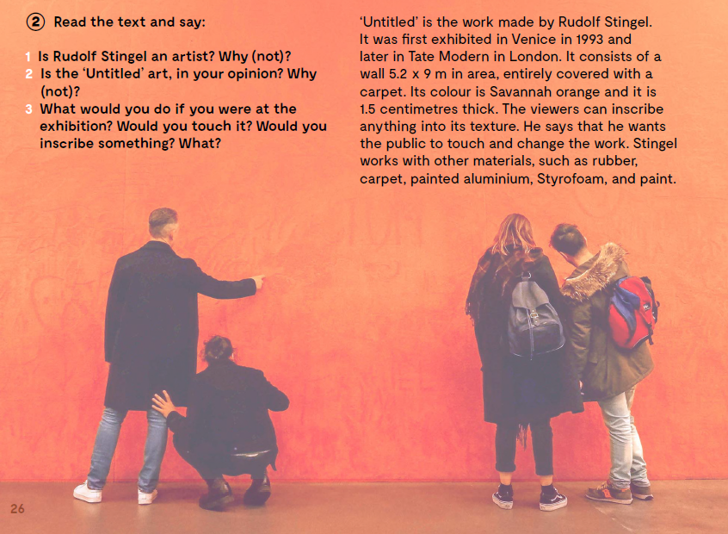
Read the text and say.
Is Rudolf Stingel an artist? Why (not)?
Is the ‘Untitled’ art, in your opinion? Why (not)?
What would you do if you were at the exhibition? Would you touch it? Would you inscribe something? What?

Slide 5
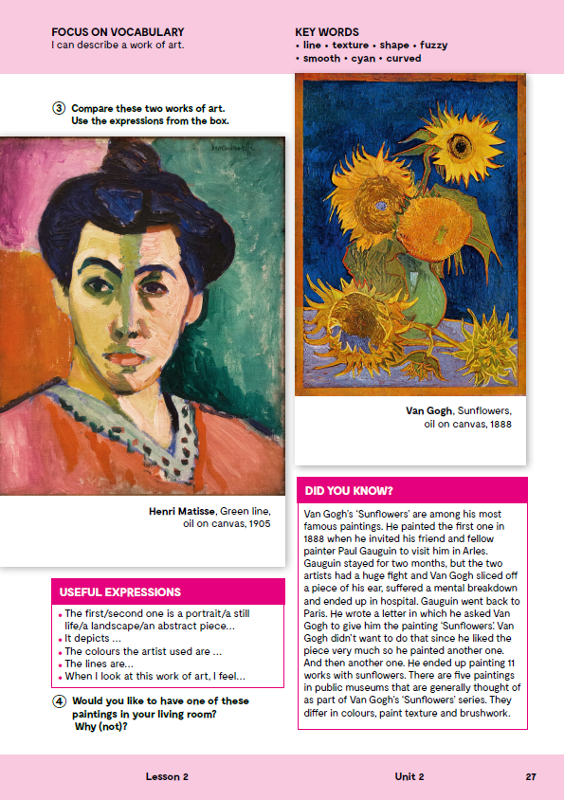
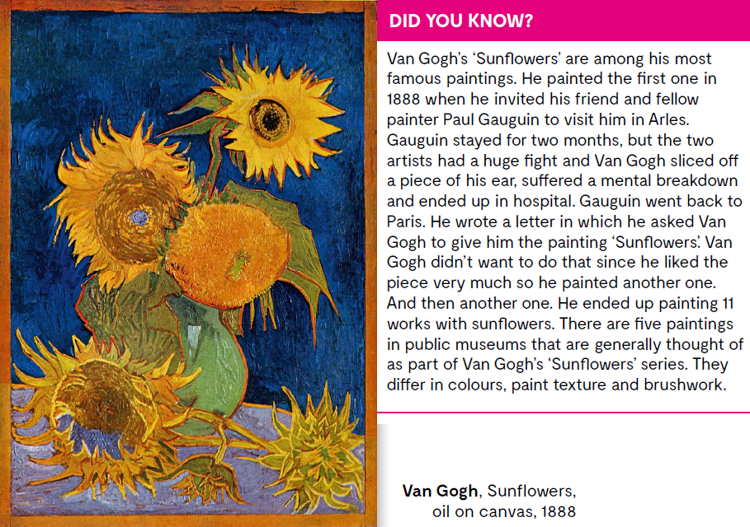
Read the text.

Slide 6

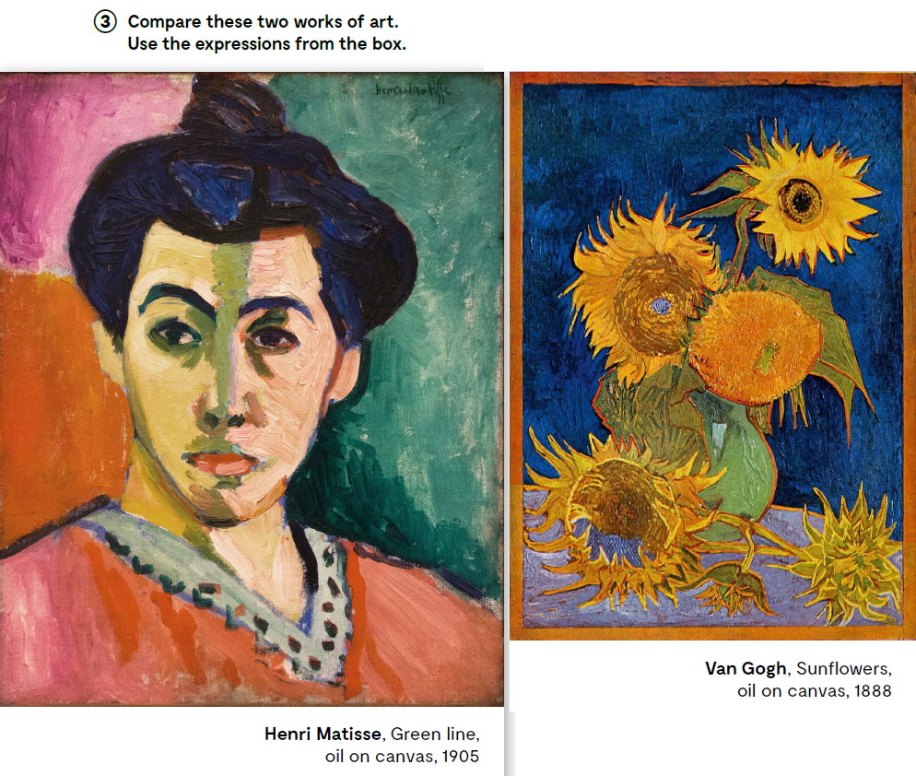
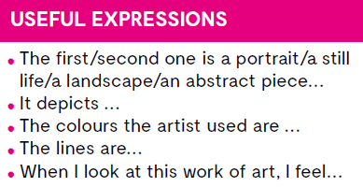
Compare these two works of art. Use the expressions from the box.
Would you like to have one of these paintings in your living room? Why (not)?

Slide 7
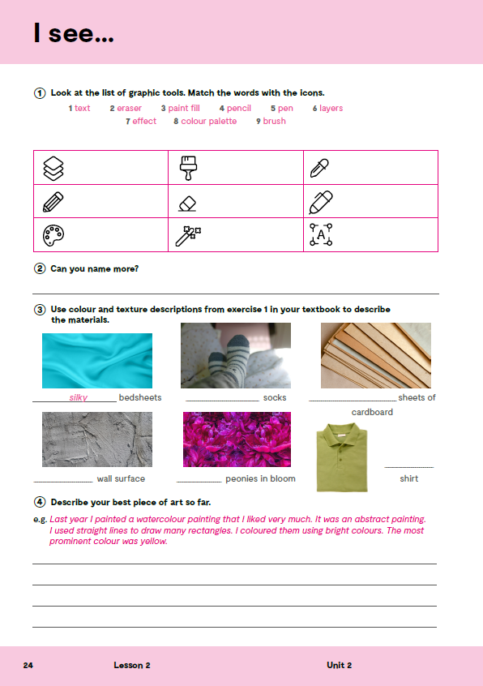
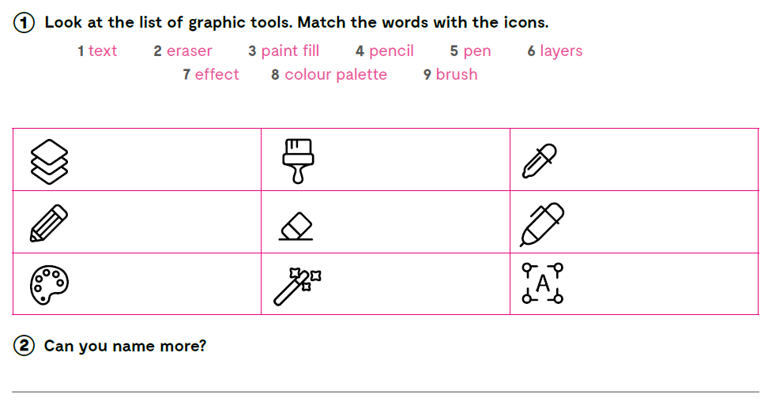
Look at the list of graphic tools. Match the words with the icons. Can you name more?
layers
brush
paint fill
pencil
eraser
pen
colour palette
effect
text
Check what you have learnt: https://wordwall.net/play/12035/221/488

Slide 8
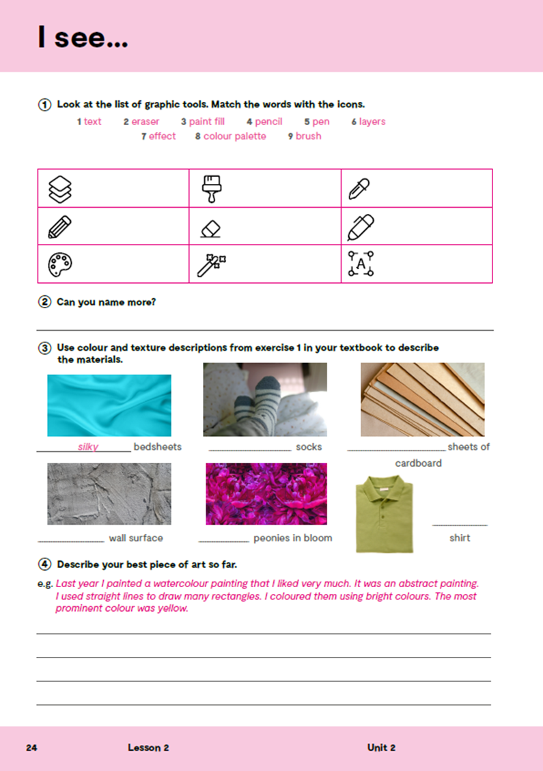
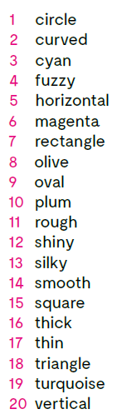
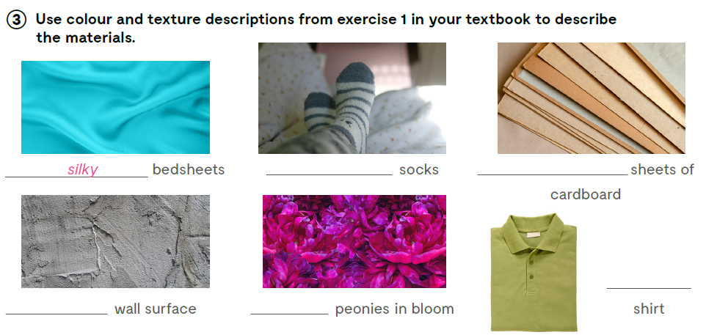
Use colour and texture descriptions from exercise 1 in your textbook to describe the materials.
fuzzy
thick
olive
rough
magenta

Slide 9
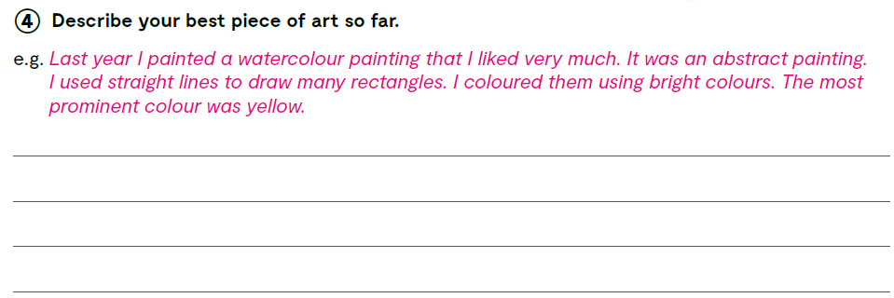
Describe your best piece of art so far.

Slide 10

Open the following link and then click on LEARN MORE! https://www.e-sfera.hr/dodatni-digitalni-sadrzaji/6ee21f35-8dbb-4258-ad16-70bc5ac60c0d/
Famous women artists
Read the text about Augusta Savage, one of the first African American women sculptors in history, Frida Kahlo, one of the best loved painters of the 20th century, Yayoi Kusama, one of the most important living artists from Japan, and Marina Abramović, a performance artist from Belgrade who studied in Zagreb, and who uses sound, video, photography, and sculpture in her work.
Did you find out something new?
Do the tasks bellow the text.

